Slide 1
ISO/TC 261 – ASTM F42 joint meetings 9 – 13 Sep 2024
at MTC in the UK
Ben Dutton, David Wimpenny
15th April 2024

Slide 2
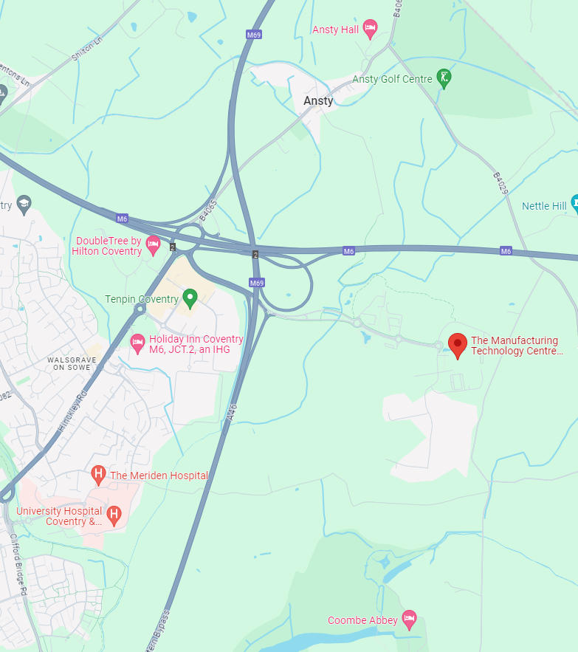
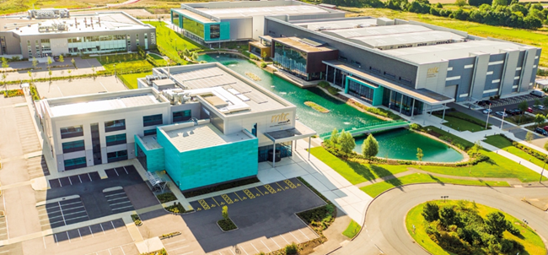
Place
AMTC (Advanced Manufacturing Training Centre)
Pilot Way
Ansty Park
CV7 9JU
Coventry, UK

Slide 3
Travelling/Airports
Birmingham Airport (BHX) - 20 miles (35 minutes* by car or via train to Coventry and then take a taxi or bus x30)
Heathrow Airport (LHR) - 102 miles (1hr 35 minutes* by car or via train or coach to Coventry and then take a taxi or bus x30)
Luton Airport - 69 miles (1hr 18 minutes* by car or via train to Leicester or Coventry and take a taxi)
Nottingham East Midlands Airport – 53miles (1hr 6 mins* by car)
*in clear traffic conditions

Slide 4
Hotels
Coombe Abbey (Brinklow Rd, Binley, Coventry CV3 2AB)
Premier Inn Coventry East (Combe Fields Rd, Ansty, Coventry CV7 9JP)
DoubleTree by Hilton Coventry (Paradise Way, Walsgrave on Sowe, Coventry CV2 2ST)
Holiday Inn Coventry M6, JCT.2 (Hinckley Rd, Coventry CV2 2HP)

Slide 5
Timetable
Monday 9th September: ASTM CoE Workshop
Tuesday 10th September to Thursday 12th September: JWs and WGs meetings
Friday 13th September: ISO Plenary
Stands will be available in the Industrial Exhibition the whole week
More details to come…

Slide 6
MTC Visits
MTC National Centre for Additive Manufacturing (NCAM) [https://ncam.the-mtc.org/]
AMTC Apprenticeship facilities [https://apprenticeships.the-mtc.org/apprenticeships/]

Slide 7
Social Events
Coombe Abbey Medieval Night
https://www.coombeabbey.com/visit/events/event-types/event-banquets/

